Slide 1
Energetic compensation breaks down over time in a desert rodent community
Renata M. Diaz and S. K. Morgan Ernest
ESA Annual Meeting, August 2021

Slide 2

Energetic compensation: declines or extinctions of some species are offset by increases from others, so total community energy use is maintained.
Ernest et al. 2008 American Naturalist
Rodent silhouettes by Marcela Diaz
Notes:
Explain hypothetical scenario
Consistent with zero-sum competition
By definition means community function is more stable than species

Slide 3
When observed, energetic compensation is consistent with a zero sum competitive dynamic. Dispersal limitation can delay compensati Energetic compensation renders community-level function less variable than individual species’ abundances.
Chesson 2001 Ann. Rev. Ecology and Systematics

Slide 4
For energetic compensation to occur, some species must have identical or overlapping traits relating to both resource use and environmental tolerances.
Kelt et al. 2015 Ecology
Thibault et al. 2010 Oikos

Slide 5
Competition and compensation have an inherent temporal dimension. Dispersal limitation can delay compensati Changing conditions may affect similar competitors in different ways.
Chesson 2001 Ann. Rev. Ecology and Systematics

Slide 6
Competition and compensation have an inherent temporal dimension. Dispersal limitation can delay compensati Changing conditions may affect similar competitors in different ways.
Chesson 2001 Ann. Rev. Ecology and Systematics

Slide 7
Competition and compensation have an inherent temporal dimension. Dispersal limitation can delay compensation Changing conditions may affect similar competitors in different ways.
Chesson 2001 Ann. Rev. Ecology and Systematics

Slide 8
How do changing environmental conditions modulate energetic compensation over time?

Slide 9
Long-term experiments: The Portal Project
Kangaroo rats
Excluded from experimental
plots since 1977
Bailey’s pocket mouse
Established at site ~1996
Other small granivores
Present since 1977
Ernest et al. 2018 bioRxiv

Slide 10
Very little compensation occurred prior to 1996.
Ernest and Brown 2001 Science
Thibault et al. 2010 Oikos

Slide 11
Strong compensation began in 1996, driven by C. baileyi ( ).
Ernest and Brown 2001 Science
Thibault et al. 2010 Oikos

Slide 12
Small granivores have increased their share of community energy use.

Slide 13
C. baileyi has declined since 2010, in a period of drought (red bars).

Slide 14
How have these changes impacted energetic compensation?

Slide 15
Other small granivores may now be compensating, in place of C. baileyi.
Ernest and Brown 2001 Science
Thibault et al. 2010 Oikos

Slide 16
Or, compensation may have broken down.
Ernest and Brown 2001 Science
Thibault et al. 2010 Oikos

Slide 17
Compensation has declined with C. baileyi.
Ernest and Brown 2001 Science
Thibault et al. 2010 Oikos

Slide 18
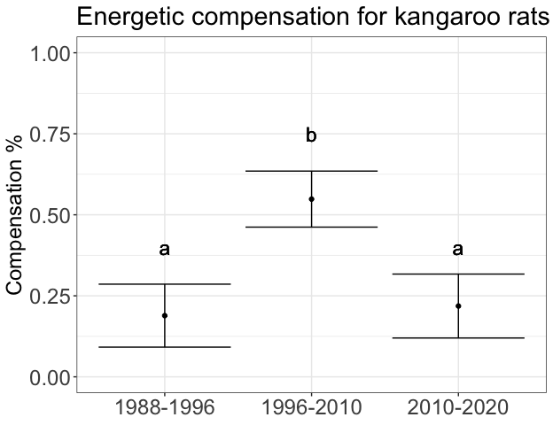
Generalized least squares accounting for temporal autocorrelation (nlme)
Contrasts via emmeans: a-b both p < 0.001, a-a p = .9

Slide 19
Generalized least squares accounting for temporal autocorrelation (nlme)
Contrasts via emmeans: a-b p < 0.001, b-c p = 0.002, a-c p = .039

Slide 20
C. baileyi is still present, and resources are still available, but C. balieyi is no longer abundant enough to compensate for kangaroo rats. Under present conditions, additional factors limit C. baileyi and prevent compensation.

Slide 21
C. baileyi is still present, and resources are still available, but C. balieyi is no longer abundant enough to compensate for kangaroo rats. Under present conditions, additional factors appear to limit C. baileyi and prevent compensation.

Slide 22
Despite a sitewide shift favoring small granivores, small granivores (other than C. baileyi) have not increased their compensation for kangaroo rats. Under present conditions, additional factors limit C. baileyi and prevent compensation.

Slide 23
Implications for energetic compensation more broadly…

Slide 24
As conditions change, compensation may come and go within a single assemblage.

Slide 25
Zero-sum competitive dynamics may be intermittent and contingent on changing conditions.

Slide 26
Maintenance of community-level function despite species extinctions depends on both the remaining species in an assemblage and how their competitive dynamic changes as conditions shift.

Slide 27
Thank you, and I look forward to any questions!
Live discussion: Tuesday, August 3 at 2pm EST
Contact: renata.diaz@weecology.org; @diaz_renm

Slide 28

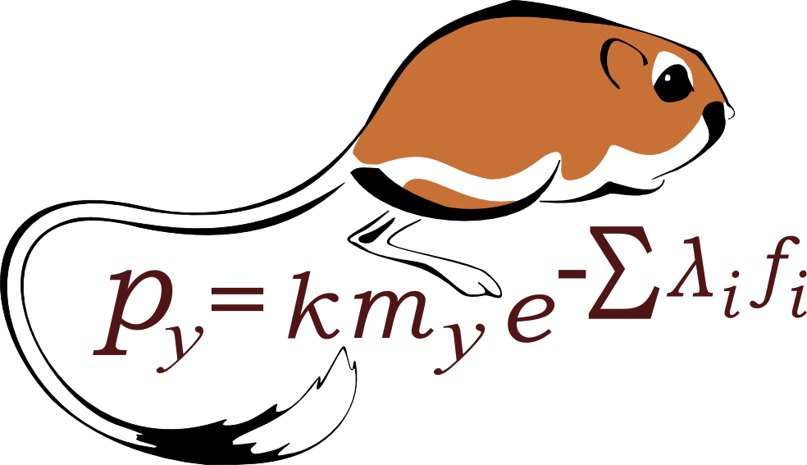
Acknowledgements

Slide 29
References
Chesson, P. 2000. Mechanisms of Maintenance of Species Diversity. Annual Review of Ecology and Systematics 31:343–366.
Ernest, S. K. M., and J. H. Brown. 2001. Delayed Compensation for Missing Keystone Species by Colonization. Science 292:101–104.
Ernest, S. K. M., J. H. Brown, K. M. Thibault, E. P. White, and J. R. Goheen. 2008. Zero Sum, the Niche, and Metacommunities: Long‐Term Dynamics of Community Assembly. The American Naturalist 172:E257–E269.
Ernest, S. K. M., et al. 2018. The Portal Project: a long-term study of a Chihuahuan desert ecosystem. bioRxiv:332783.
Kelt, D. A., J. R. Aliperti, P. L. Meserve, W. B. Milstead, M. A. Previtali, and J. R. Gutierrez. 2015. Energetic compensation is historically contingent and not supported for small mammals in South American or Asian deserts. Ecology 96:1702–1712.
Lenth, R. V. 2021. emmeans: Estimated Marginal Means, aka Least-Squares Means.
Pinheiro, J., D. Bates, S. DebRoy, D. Sarkar, and R Core Team. 2020. nlme: Linear and Nonlinear Mixed Effects Models.
Thibault, K. M., S. K. M. Ernest, and J. H. Brown. 2010. Redundant or complementary? Impact of a colonizing species on community structure and function. Oikos 119:1719–1726.
Van Valen, L. 1973. A new evolutionary law. Evolutionary Theory 1:1–30.

Slide 33
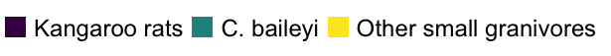

Slide 34
Strong compensation began in 1996, driven by C. baileyi ( )
1989 - 1996
1996 - 2010
16% compensation for kangaroo rat removal
Energy use on exclosures 25% of controls
52% compensation for kangaroo rat removal
Energy use on exclosures 67% of controls
Ernest and Brown 2001 Science
Thibault et al. 2010 Oikos

